Slide 1

Welcome

Slide 2


Result Analysis
Submitted By:-
Shukla Saurabh (160133107026)
Project Guide:
Prof. Bijal U Gadhiya

Slide 3

What is a Result Anlysis?
“RESULT ANALYSIS” gives us idea about how the analysis of the result store in the database can be done and also how it is useful to Institute/University. The system will utilize the large result set and then by processing it will provide various reports on comparison on student’s result.
For Academicians, currently there is no information available to analyze the performance of department. We will generate reports based on analysis of institute result set and suggest where the department should focus on improvement on particular subject too.

Slide 4
Result Analysis Motto
For Students currently their result is calculated, stored in the database and displayed simply on the University Portal.
The subject’s marks are represented in the form of grades and result is represented by a special value called SPI (Semester Percentage Index), CPI (Cumulative Performance Index), and CGPA (Cumulative Grade Point Average). So, here we will calculate percentage of student’s result.
Also there is no comparison of individual student’s result with other student’s result. So here we will try to add this feature as our key feature to improve student’s performance by comparing each other’s result.
Result Analysis refine data stored in database and generate various analysis reports.
To have easy access for students for any information from anywhere.

Slide 5
Main Actors Of our System
Admin
Institute
Students
Notes:
What is the Roadmap for the product / approach to releases?
The Version Release Strategy section describes how the project will deliver incremental sets of features and functions in a series of releases to completion. The Version Release Strategy enables the business to plan for an orderly implementation of the solution and defines how the scope can be allowed to flex.

Slide 6

Main modules of our system
User Login.
Students Detail Upload.
View Result GTU wise.
View Result College wise.
Filter Result Branch wise.
View all students details.
View student backlog details.
View student marks details.
Faculty feedback facility.
Upload placement detail.

Slide 7
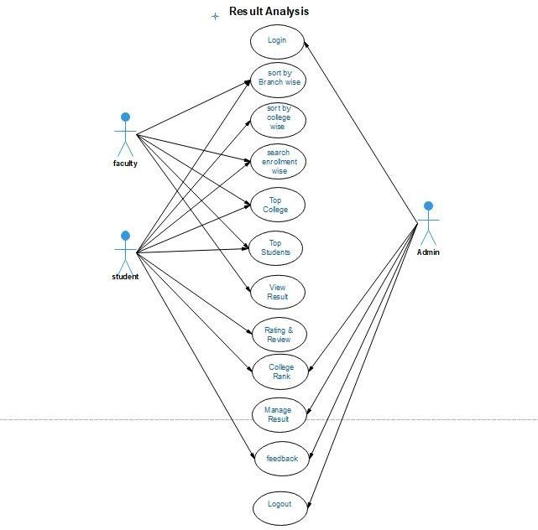
Use Case Diagram of “ResultAnalysis”

Slide 8
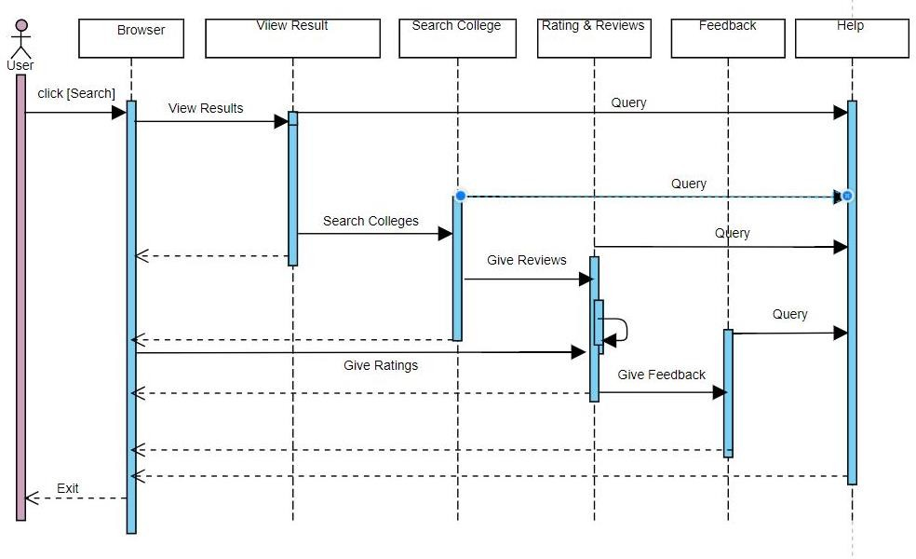
Sequence Diagram of “ResultAnalysis”

Slide 9


Development Tools
ASP.NET MVC
SQL Server

Slide 10
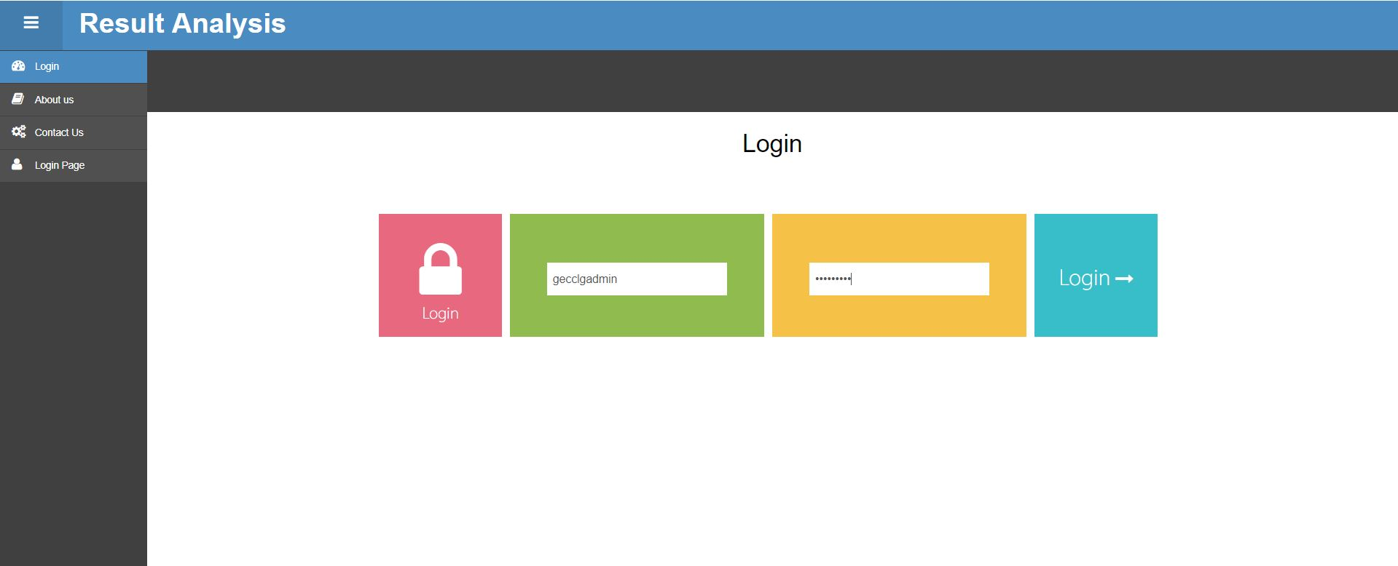
Glimps of “Result Analysis”
(1) Login

Slide 11
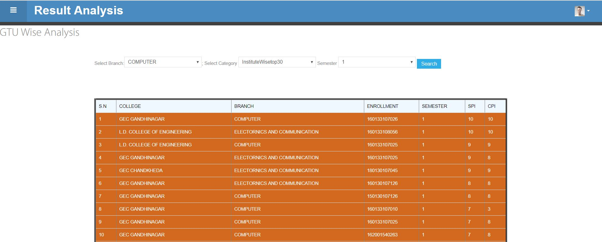
Glimps of “Result Analysis”
(2) GTU wise result search.

Slide 12
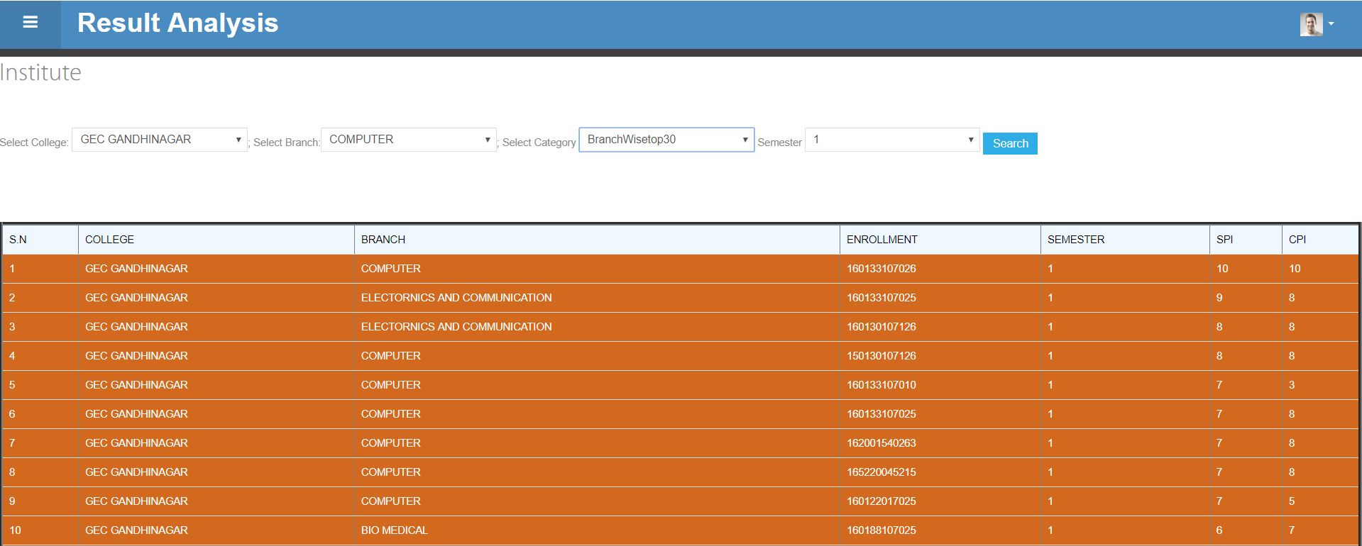
Glimps of “Result Analysis”
(3) Institute wise result search.

Slide 13
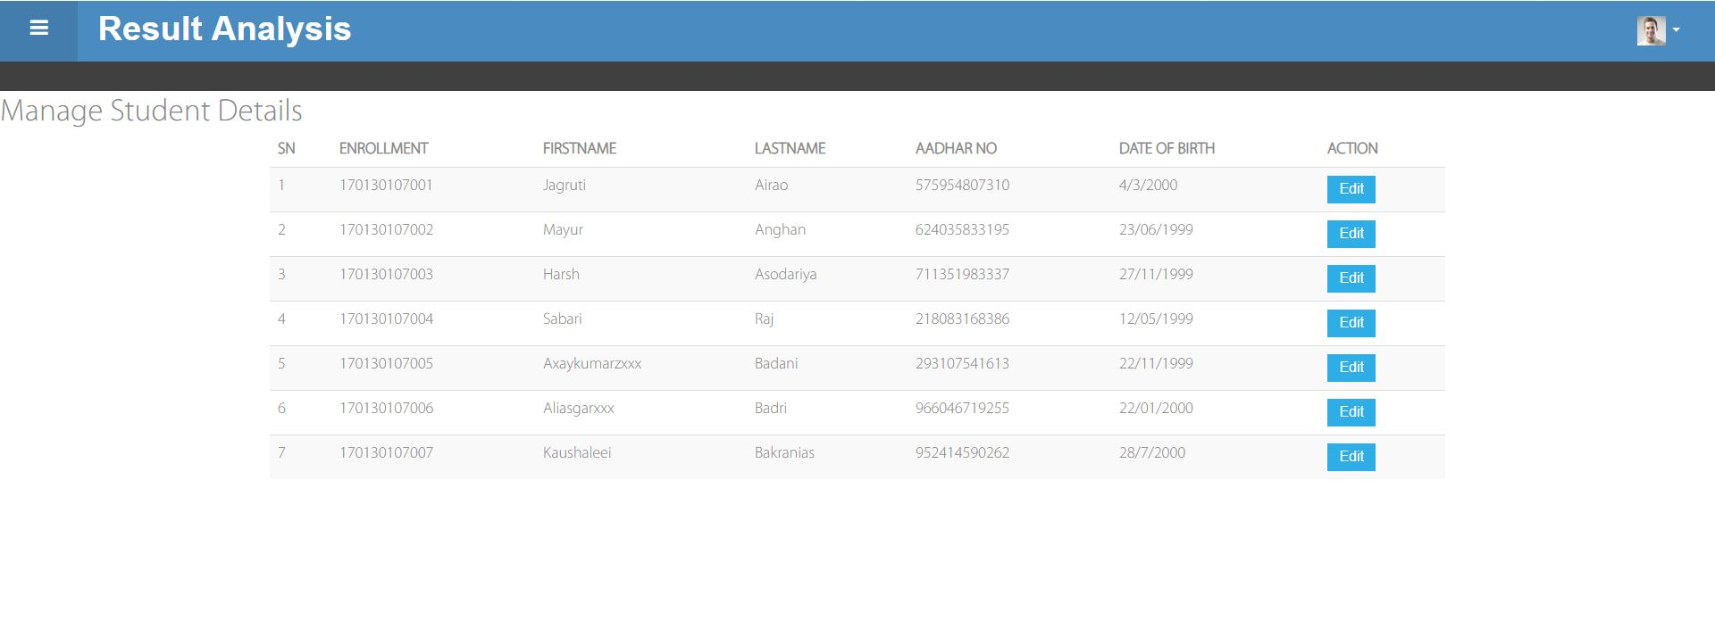
Glimps of “Result Analysis”
(4) Manage Students details.

Slide 14
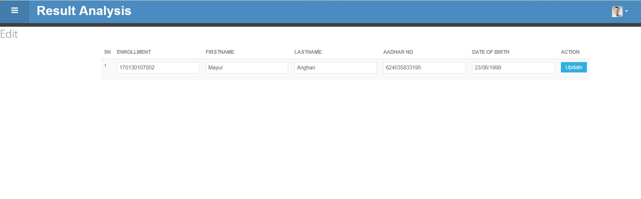
Glimps of “Result Analysis”
(5) Update Students details.

Slide 15
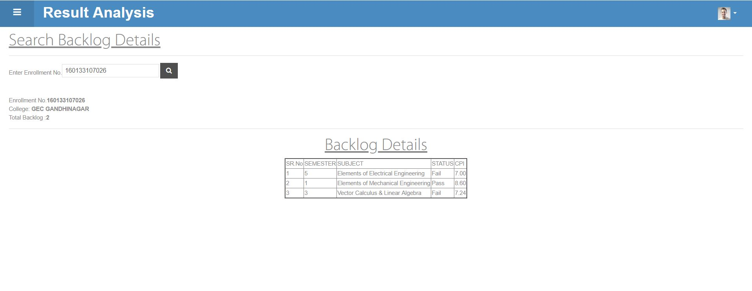
Glimps of “Result Analysis”
(5) Backlog details.

Slide 16
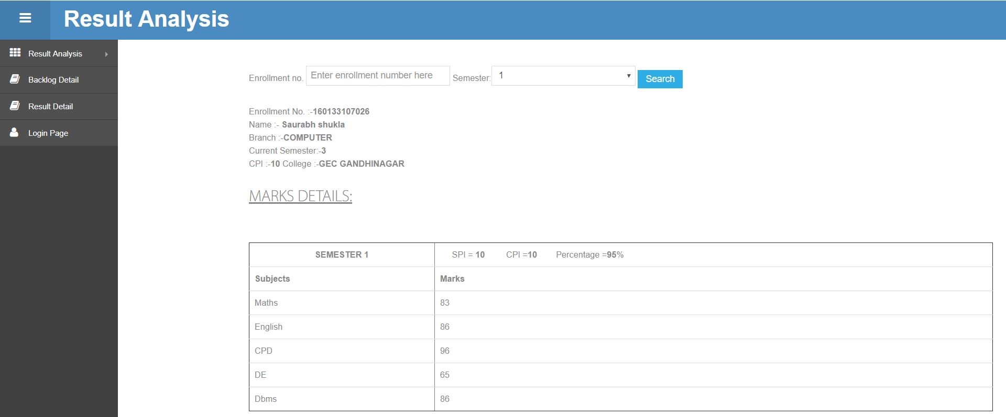
Glimps of “Result Analysis”
(6) Marks details.

Slide 17
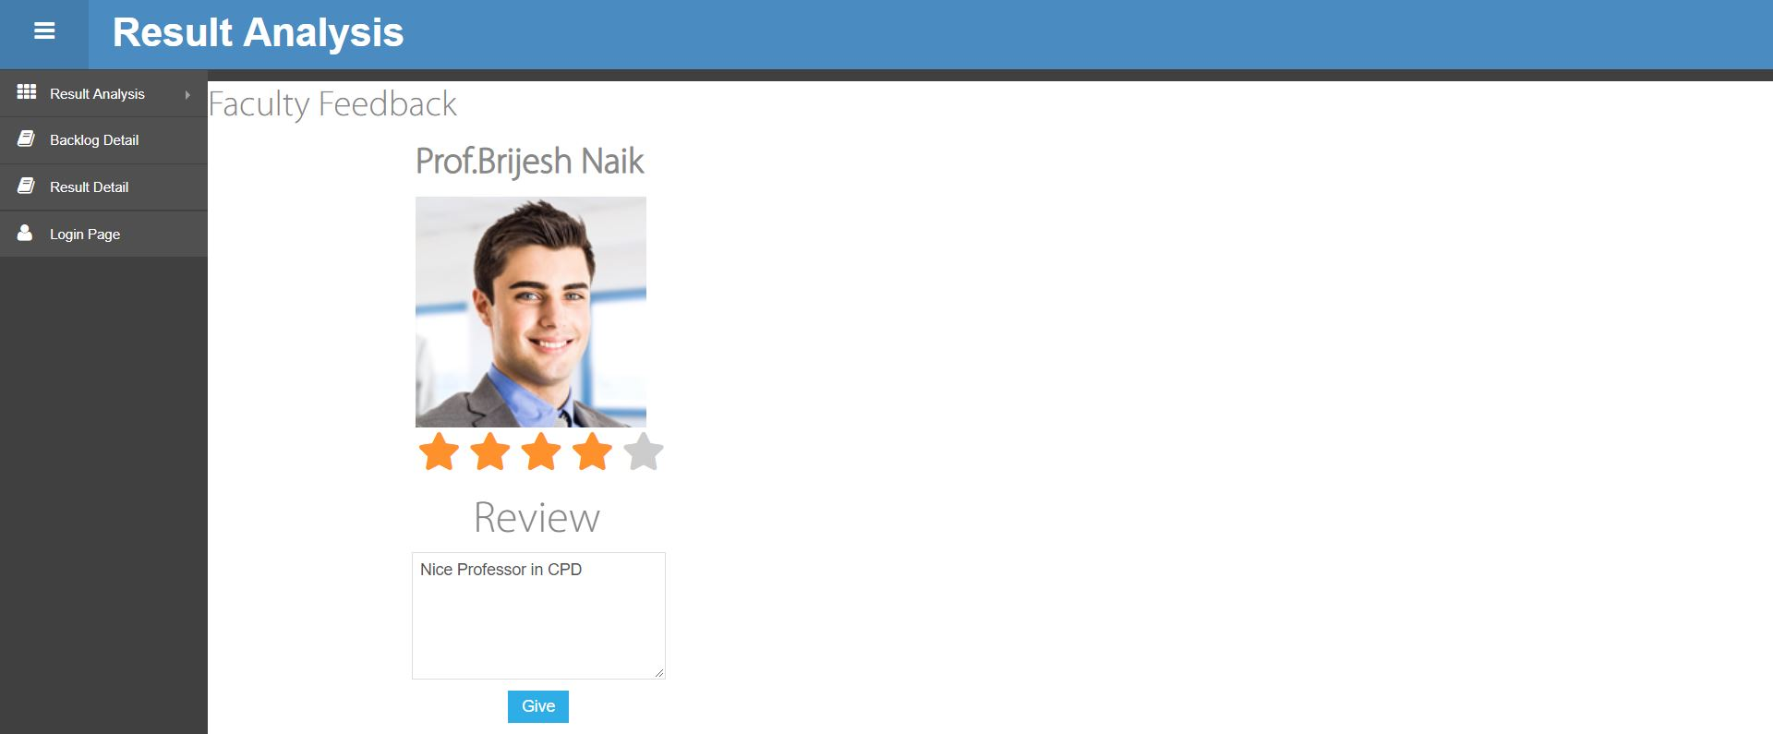
Glimps of “Result Analysis”
(7) Give Feedback.

Slide 18
Features of “Result Analysis”
1.
To improve student’s performance by comparing each other’s result.
2.
To refine data stored in database and generate various analysis reports.
3.
Automatically calculate percentage of student’s result.
4.
We will generate reports based on analysis of institute result set and suggest where the department should focus on improvement on particular subject too.

Slide 19
Challenges
1.
Learning ASP.NET mvc is challenging task for us.
2.
Data dictionary is complex and quite difficult to manage.
3.
Razor syntax is little bit difficult to learn and understand.

Slide 20
Future Enhancement
Software is continuously changing entity. Software should be reflected with new features whenever new requirements emerges.
Software evolution is one of big phase in any software’s life cycle. We have to project towards some newly emerged and previously implemented and installed into its essential environment.
We have to examine newly emerging requirements , misinterpretation of older requirements, impact due to omission of some important requirements, and failure of some features. For our prepared system we are willing to provide some new features, which can help the users in prodigious way, they are as noted below.
Better format for reports generation.
Automatic Questionpaper generation on gtu admin side.

Slide 21

Question And Query??

Slide 22


